Slide 1


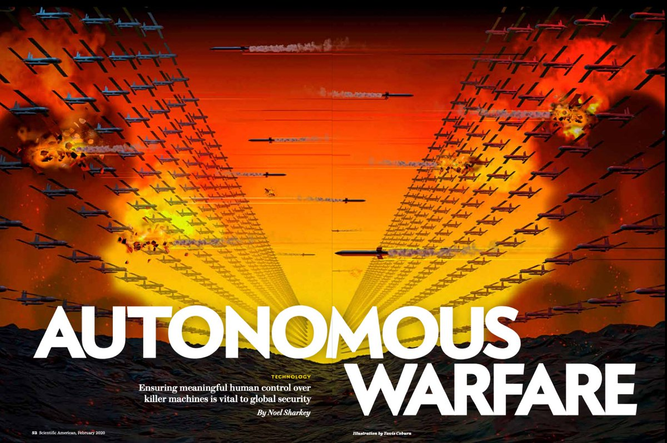
Mme
Ignatiana
SHONGEDZA
Presented by:
Amine DJEGHRI
Ivan KACHAIKIN
February 2020
Notes:
Hello, everyone. Thank you for having us. My name is __ and this is my partner ______,
and we're going to do a presentation about Autonomous warfare

Slide 2
Summary
Introduction
AWS
Risks and dangers associated with AWS
Conclusion

Slide 3
Introduction
Notes:
Let’s begin with the introduction

Slide 4
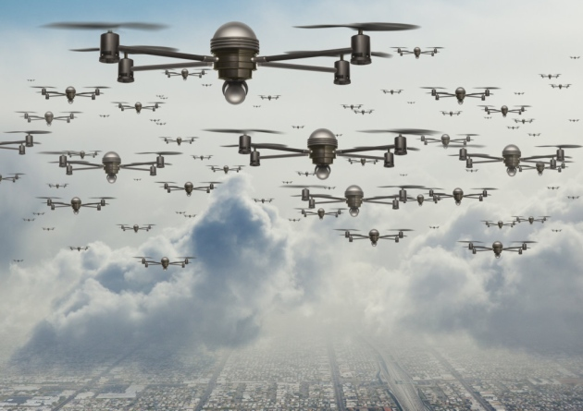
Introduction
September 2019 a swarm of 18 bomb-laden drones and seven cruise missiles crashed into oil fields and their processing facilities in Saudi Arabia
Experts suppose that the drones were not fully autonomous
They did not communicate with one another to choose their own targets
Perhaps, they were programmed
Notes:
Saudi Arabia:
Yemen’s Houthi rebels were claimed responsible for this sophisticated attack
Twice reduction of the nation’s output of crude oil and natural gas
An increase in global oil prices
Perhaps, they were programmed to attack a precise point of the world’s map whose coordinates were provided by a satellite positioning system

Slide 5
Introduction
Moreover, Turkey has announced plans to launch autonomous quadcopters in Syria by early 2020
Once launched, quadcopter might find, track, select and attack targets with violent force
All without human’s control or supervision
Russia is also developing aerial swarms for that region

Slide 6
Autonomous weapons

Slide 7
AWS
Autonomous Weapons Systems (AWS) are a type of autonomous military robot that can independently search for and engage targets without human’s involvement
Kargu, the Turkish quadcopter
The Modular Advanced Armed Robotic
System, developed by Qinetiq
Notes:
In the mid-2000s, U.S. triggered the development of AWS
Since that time, every major power and several lesser ones have been striving to acquire these systems
-China, U.S. and Russia are working on or have already demonstrated some AWS
- Furthermore, Chine is already exporting AWS to the Middle East

Slide 8
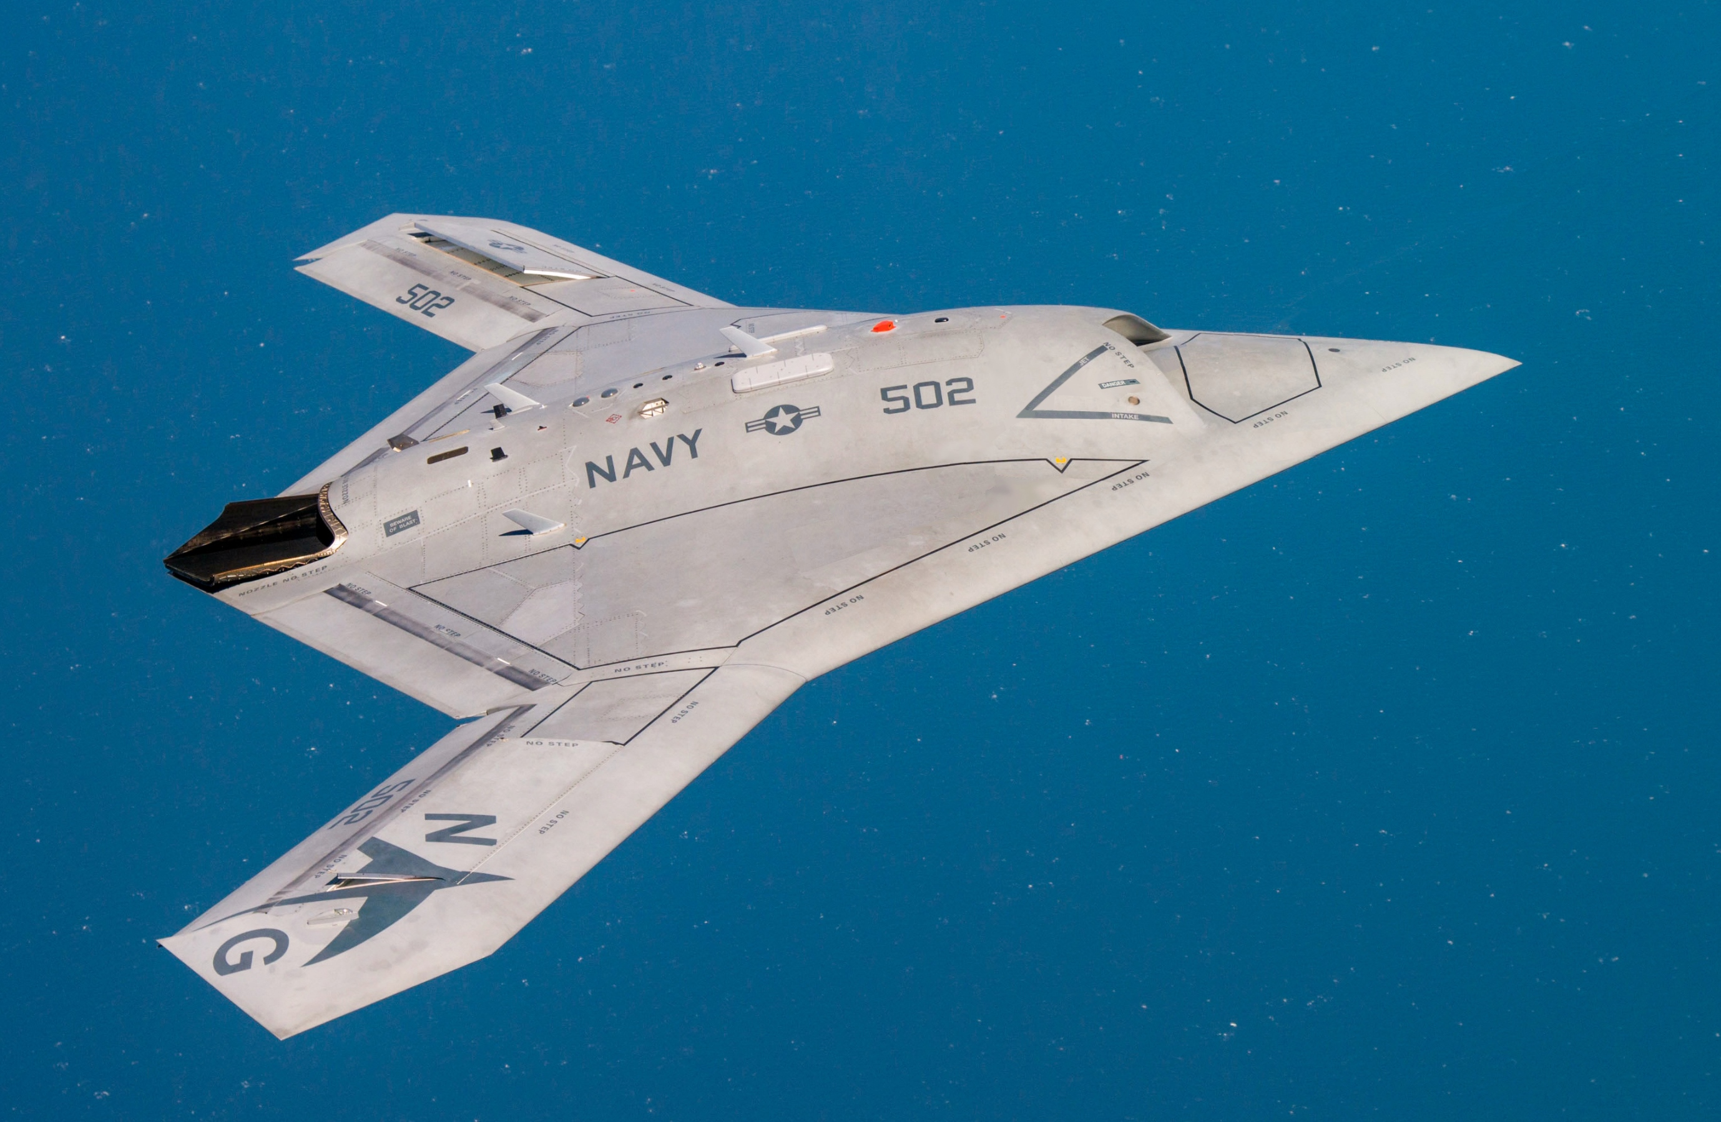
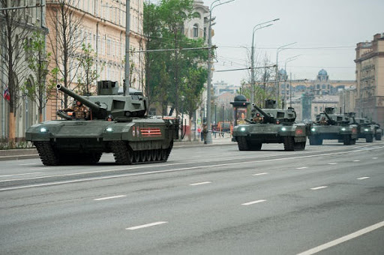
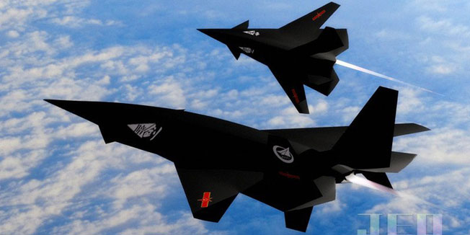
AWS
U.S. Navy’s X-47B, that land and takeoff on windly conditions, 10 times the reach of piloted
fighter jets, refuel in the air
Russian T-14 Armata, that might be automated in the next generation
Chinese Anjian, that could twist and turn so sharply and quickly that the g-force generated would kill a human pilot

Slide 9
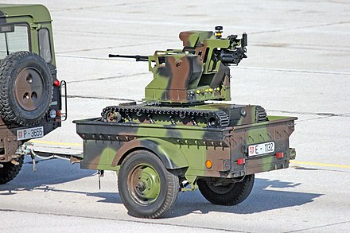
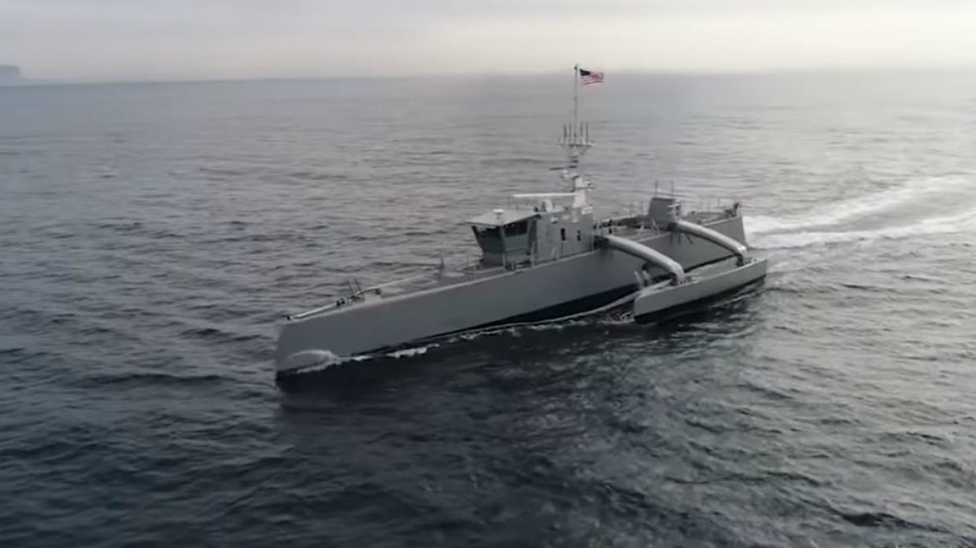
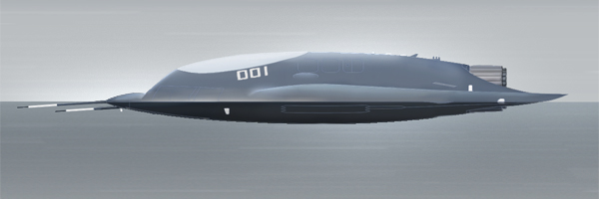
AWS
Serbian Land Rover Defender
towing trailer with "Miloš"
tracked combat robot
U.S. Sea Hunter, supporting following features: meeting or surpassing all performance objectives for speed, maneuverability, stability, seakeeping, acceleration/deceleration, fuel consumption, and mechanical systems reliability in the open-ocean.
Chinese AVIC 601-S, that has low-observable flying wing UAV

Slide 10
Risks and dangers associated with AWS

Slide 11
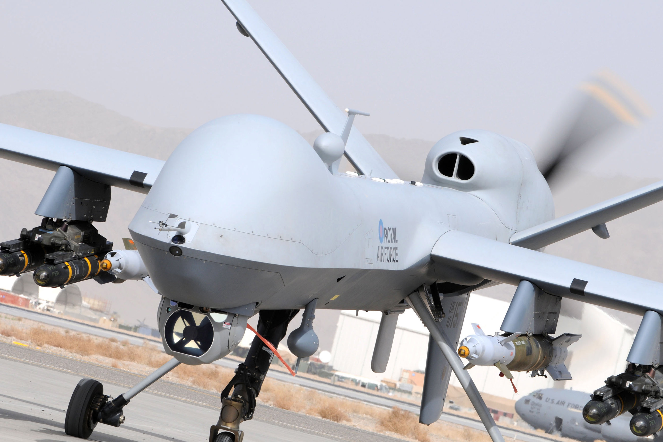
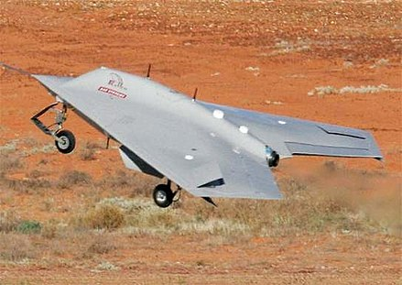
Risks and dangers associated with AWS
On the battlefield, AWS have a few important military advantages that motivate governments as well as several defense companies to invest them
A BAE Systems Corax during flight testing

Slide 12
Risks and dangers associated with AWS
Reach some areas that were previously inaccessible
Remove human warfighters from dangerous missions
Less of warfighters are needed for a given mission
Robots and drones could perform operations much more faster than simple soldiers
A BAE Systems Corax during flight testing
Notes:
Human’s need more of ‘recharges’
Each warfighter has significantly more violent force

Slide 13
Risks and dangers associated with AWS
⚠️
Some nations, particularly U.S. and Russia, are looking only at these potential military advantages of autonomous systems disregarding the disturbing scenarios that could become true
Notes:
At the same time, roboticists criticize that approach claiming it blind and blinkered. They team up to nongovernmental organizations to form the Campaign to Stop Killer Robots in order to persuade United Nations to negotiate the legality of AWS without meaningful human control

Slide 14

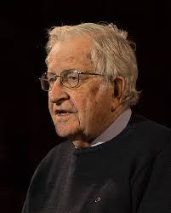

Risks and dangers associated with AWS
in July 2015, an open letter calling for a ban on autonomous weapons was released at an international joint conference on artificial intelligence
Over three thousand AI and robotics researchers have also signed the letter
Steve Wozniak
Elon Musk
Noam Chomsky
Notes:
The letter has an impressive list of signatories, including Elon Musk (inventor and founder of Tesla), Steve Wozniak (cofounder of Apple), and Noam Chomsky (Massachusetts Institute of Technology), among others..

Slide 15
Risks and dangers associated with AWS
But why scientists, businessmen and top managers do not support the idea of further development of AWS?
AWS will find it very hard to determine who is a civilian and who is a combatant, which is difficult even for humans.
It is unclear who or what are to be blamed or held liable
irreplaceability of human conscience and moral judgment

Slide 16
Risks and dangers associated with AWS
But why scientists, businessmen and top managers do not support the idea of further development of AWS?
Computers are often wrong, for example, in 1983 the nuclear war could started between the U.S. and Soviet Union because of the error at the onboard computing system on the Soviet satellites
The speed of the robots is sharply higher than the human’s one, moreover, in the decades they would become faster and faster «from fast subsonic to supersonic to hypersonic»

Slide 17
Risks and dangers associated with AWS
One another question without an answer: what happens when enemy autonomous weapons confront one another?
no one knows because it is impossible to predict how two complex systems controlled by top-secret computer algorithms would entertain between each other…
Example
A bookseller was selling a book of the cost around $50 for $23,698,655.93 within a week because of unpredicted behavior of confrontation between two simple and well-known algorithms.

Slide 18
Risks and dangers associated with AWS
Imagine now two AWS instead of these algorithms, what would happen?
It is 2040, and thousands of autonomous weapons are distributed along Russia’s border with Europe
Suddenly, a sensor of an autonomous tank glitch triggered a confrontation mode, it fires a missile over the horizon, and a civilian airliner goes down in flames
NATO’s autonomous AWS that recognized an attack took off much more faster that the governments could understand
What’s next?

Slide 19
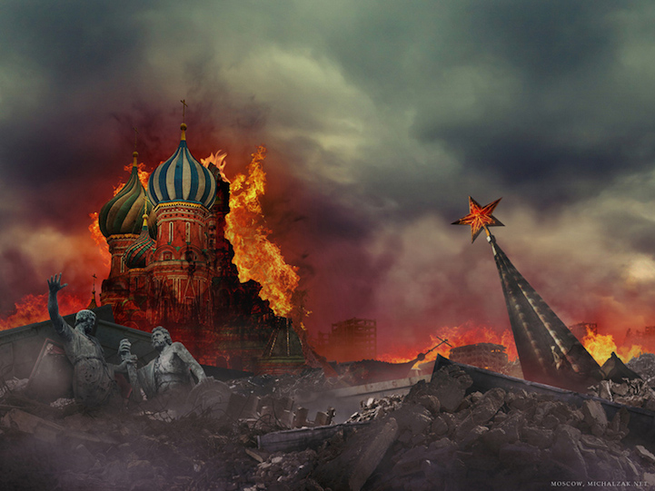


Risks and dangers associated with AWS
The consequences would be destructive…
Moscow, Russia
Paris, France
Brussels, Belgium

Slide 20
Conclusion

Slide 21
Conclusion
Human is important !
Only a human expert that has:
Full awareness of the situation and context
Sufficient time to deliberate on the nature
Significance and legitimacy of the targets
The feel of the necessity and appropriateness of an attack and the likely outcomes
Should determine whether or not the attack will commence,
not the system by itself

Slide 22
Conclusion
Solutions
✅
Even if thousands of scientists and many companies supported an idea that it is necessary to negotiate bans on AWS,
❌
several governments oppose them, in particular the U.S., Russia, Israel and Australia.
As we find it hard to imagine nations agreeing to return to a world in which weapons had no measure of autonomy:
"Autonomous" weapons should always be under significant human control.
Adaptive learning devices should therefore be designed so that they are capable of clearly explaining their reasoning and decisions to operators

Slide 23
Conclusion
In your opinion:
Should we ban the development of AWS?
Would robots make more mistakes on the battlefield than the human?
Imagine now that an autonomous warrior miss-classified civils as enemies and killed them. Who should be responsible for that?

Slide 24
Thank you for your attention

Slide 25
Do you have any questions ?
28

Slide 26
Sources
Sources
https://www.scientificamerican.com/article/fully-autonomous-weapons-pose-unique-dangers-to-humankind/
https://www.armscontrol.org/act/2019-03/features/autonomous-weapons-systems-laws-war
https://www.law.upenn.edu/institutes/cerl/conferences/ethicsofweapons/
https://news.cnrs.fr/opinions/a-guide-to-lethal-autonomous-weapons-systems
https://www.armyupress.army.mil/Journals/Military-Review/English-Edition-Archives/May-June-2017/Pros-and-Cons-of-Autonomous-Weapons-Systems/
29

Slide 27
Images Sources
Sources
Slide 1: Scientific American
Slide 4: https://www.theneweuropean.co.uk/top-stories/fred-harter-and-giles-whittell-on-the-rise-of-the-drone-in-warfare-1-6512781
Slide 7: https://cacm.acm.org/magazines/2017/5/216318-toward-a-ban-on-lethal-autonomous-weapons/abstract https://www.aviationtoday.com/2019/12/02/companies-developing-lethal-autonomous-weapons-as-groups-seek-ban-report-says/
Slide 8: https://en.wikipedia.org/wiki/Northrop_Grumman_X-47B
http://www.opex360.com/2019/11/20/larmee-russe-va-bientot-recevoir-un-premier-lot-de-chars-t-14-armata-en-version-experimentale/
https://velkaton.ba/anjian-prva-supersonicna-bespilotna-letjelica/
Slide 9: https://en.wikipedia.org/wiki/Lethal_autonomous_weapon
https://www.france24.com/fr/20180213-sea-hunter-le-premier-navire-autonome-lus-navy-sera-bientot-pret-a-passer-jusqu-a-90-jours-seul-mer
https://en.wikipedia.org/w/index.php?title=AVIC_601-S&oldid=935610884
Slide 11: https://en.wikipedia.org/wiki/BAE_Systems_Corax
Slide 13: https://fr.wikipedia.org/wiki/Steve_Wozniak
https://observer.com/2020/01/elon-musk-jack-dorsey-twitter-advice/
https://en.wikipedia.org/wiki/Noam_Chomsky
Slide 17: https://mymodernmet.com/michal-zak-the-end-of-eternity/
29

